Slide 1

A Neural Network Approach to Psychiatric Comorbidity
Georgia Smith
Advisor: Dr. James Vance

Slide 2

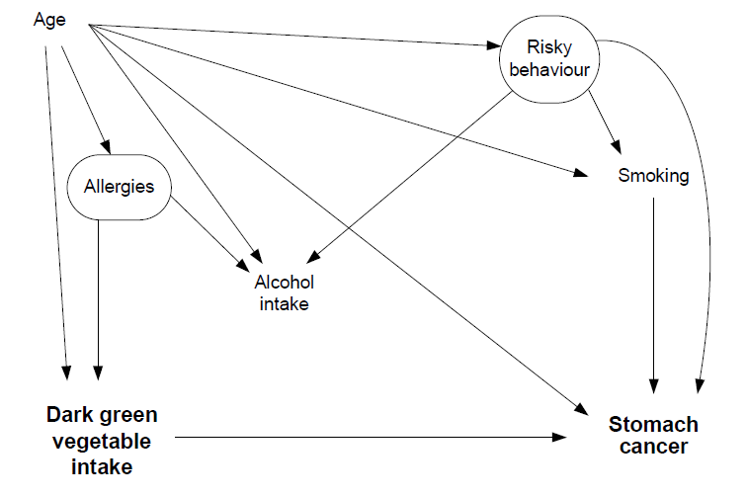
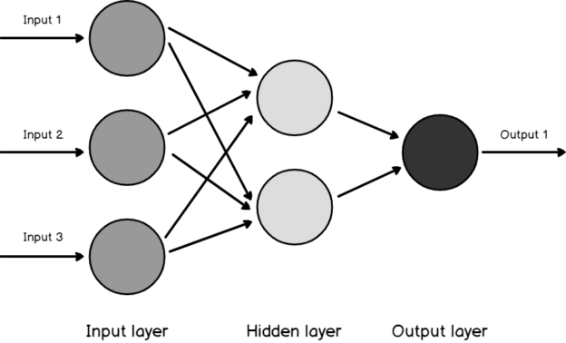
Methods
https://wangcc.me/DAG-CSS/img/dagitty-modelpaper.png
National Comorbidity Survey
Neural Networks
Long Short-Term Memory
Diffusion Network Inference
https://s33046.pcdn.co/wp-content/uploads/2020/04/three-layered-architecute-in-artificial-neural-net-624x378.png

Slide 3
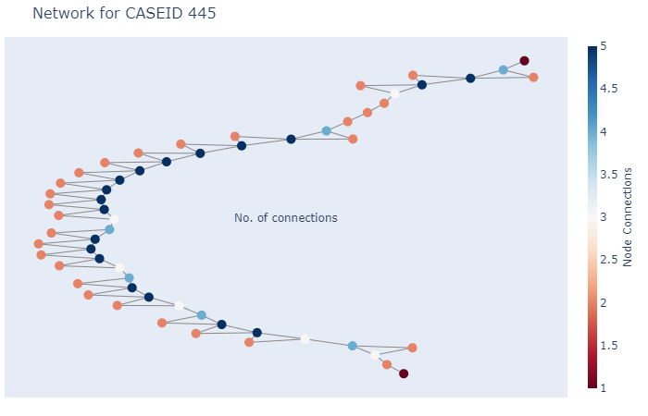
Results
Neural Network
90% Accuracy
Plans
Network to Identify Symptom Interaction

Slide 4

How did engaging in this research enhance your education and experience?
Prepared For Future
Real World Application
Use Degree for Something I’m Passionate About
https://centraloregonradiology.com/wp-content/uploads/2017/09/University-Colorado-Logo.jpg

